Slide 1
Hungary

Slide 2
Information
Hungary is a small country in Europe, and the capital city is Budapest.
Latitudes: North latitude – 47.16 , East longitude – 19.5
Our biggest river is the Danube, which is going through 10 countries and it’s 2850 km long.
Tisza is the second longest river in our country, but it is much shorter than the Danube. It is just 962 km.
Hungary’s highest point is Kékes, which is 1014 m .
We have the biggest lake in Central Europe. Lake Balaton is 78 km long, 13-14 km breadth, and 600 km².

Slide 3
Europe on world map

Slide 4
Hungary

Slide 5
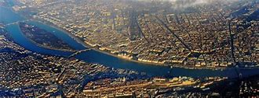
Budapest

Slide 6
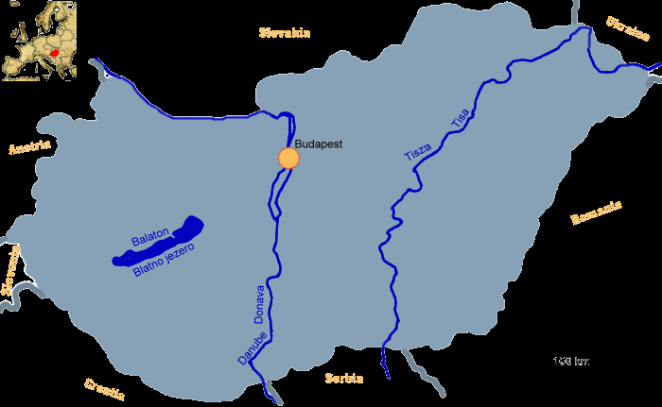
Tisza and Danube in Hungary

Slide 7
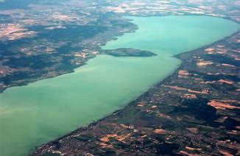
Balaton

Slide 8
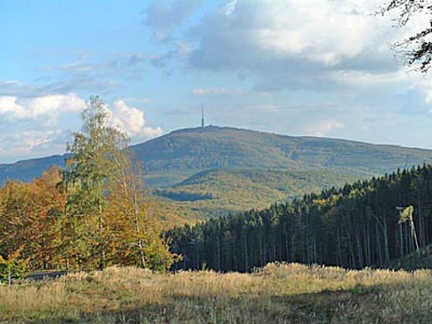
Kékes

