Slide 1
Creating a multimedia track with Google My Maps
a lesson for 10.b

Slide 2
Outdoor activities and mapping in stem

Slide 3
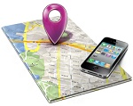
Google Mapping Tools

Slide 4
You need internet connection to use it.
Computer or mobile
Easy to find a place
Information about places: opening hours, likes …
POIs: shops, restaurants neerby
Route planning
Real time trafic information
Timetables of public transport

Slide 5
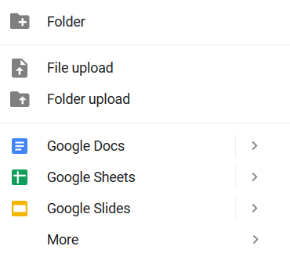
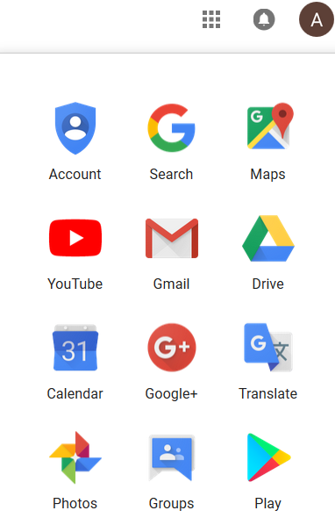
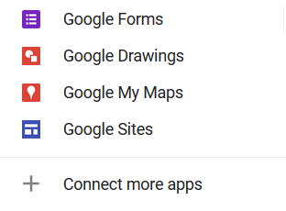
Steps to create a map with google my maps
Enter your google account / gmail
Click on the 9 dots
Click on the drive icon
Click on the new icon
Click on More
Choose Google My Maps

Slide 6
Steps to create a map in googly my maps
Name your map
Choose the satelite map
Name your layer
Add a marker to Árpád
Create another layer
Name that layer too
Add your favourite place in Budapest, and your favourite place in Hungary (outside Budapest)
Edit your markers: picture, text, colour, style

Slide 7
Sharing a map
I’m going to share a map with you.
Open it.
Add your favorite places to the correct layers.
Edit your markers. (Work in English.)
The marker’s name should include your name.
Check what your peers did.

Slide 8
Nice , beautiful
enjoyable, pleasant, pleasurable, entertaining, amusing, marvellous, good, lovely, great; stunning, attractive, adorable, charming, eye-catching, magnificent, picturesque, sweet

