Slide 1
Effective Use of Technology in the English Language Classroom
Erasmus KA1 Mobility –Anglolang course in Scarborough – July 24-August 3. 2018.
dr. Széllné Hajdú Indira

Slide 2
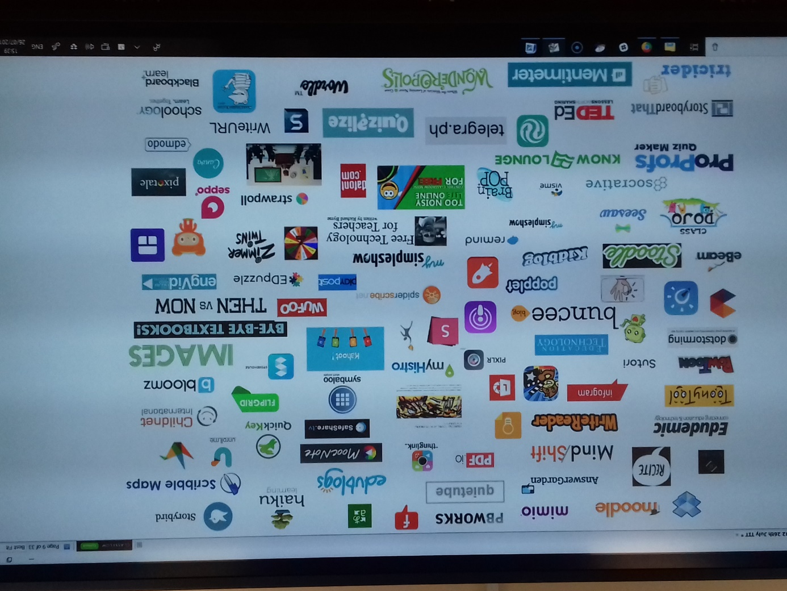
READY TO BROWSE?

Slide 3
Podcasts
For listening to – accent
Comprehension
Specific words
Modelling what sts should do
Introduce new vocab
Starting a discussion
Preview before reading
Writing reactions for it
For homework
( podcast bbc radio 4 – Great lives – topics series 45 Barbara Stocking on Catherine the Great - 30 min.
Podomatic British Accent – shorter ones
Player fm- with celebrities
Player fm – K12 Greatest Hits – The Best Ideas in Education – How some Teachers Find Time to Teach, Sleep, Live and Love)

Slide 4
Mind maps
App.mindmapmaker.com – only with facebook account
Edrawsoft.org
Canva.com
Www.mindmup.com
You can create a mind map.
Take a photo and print it with Snipping Tool.
You can write the mind map on the lesson together.
Free, but saves only for 6 months otherwise you have to sign up and pay

Slide 5
Www.canva.com
To create Posters, pictures
to advertise
To make a grammar point
Gives the layout, templetes, free photos, grids, frames, shapes, icons, illustrations, text, colour etc.
You can upload your own images
To create mind maps

Slide 6
Www.classtools.net
A lot of tools eg. below and a lot more
Random name picker (you can create your own list and download it and use again)
Connect fours (a lot of already created lists, you can create yours but I don’t know how to save it)
QR treasure hunt generator (old ones and your new ones – great)
Quiz maker
and so on.

Slide 7
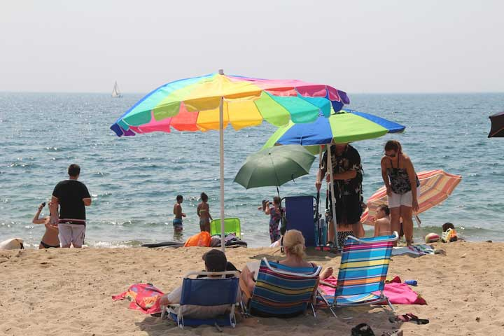
PIXLR.com
you can create pictures
modify pictures
make mystery photo
compare and contrast photos
describing pictures, describing what to do/what has been done (giving instructions to each other)
for presentations
for projects
for fun

Slide 8
Thank you for your attention.

