Slide 1
Use of Google mapping tools for international projects
Dissemination by Anna Zombori
Óbudai Árpád Gimnázium
11.02.2019.

Slide 2

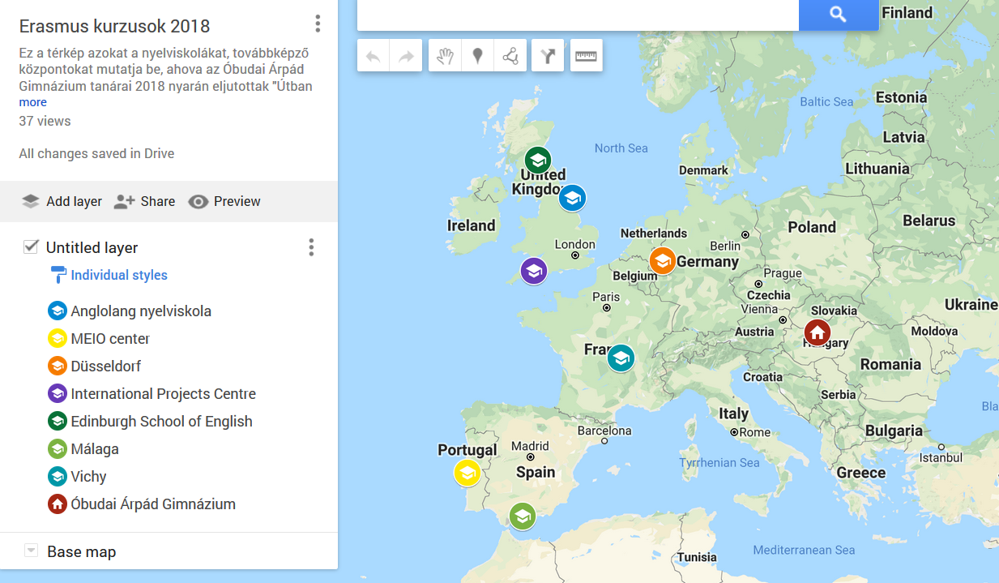
Interdisciplinar education

Slide 3


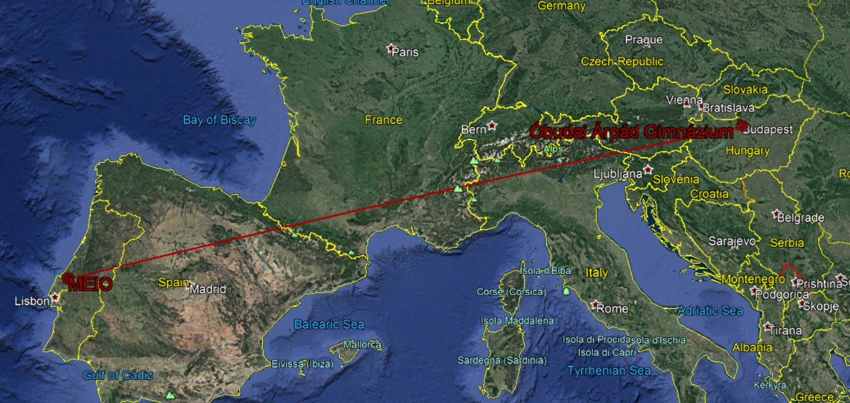
Outdoor activities and mapping in stem
http://meio.center/en/meio.html

Slide 4
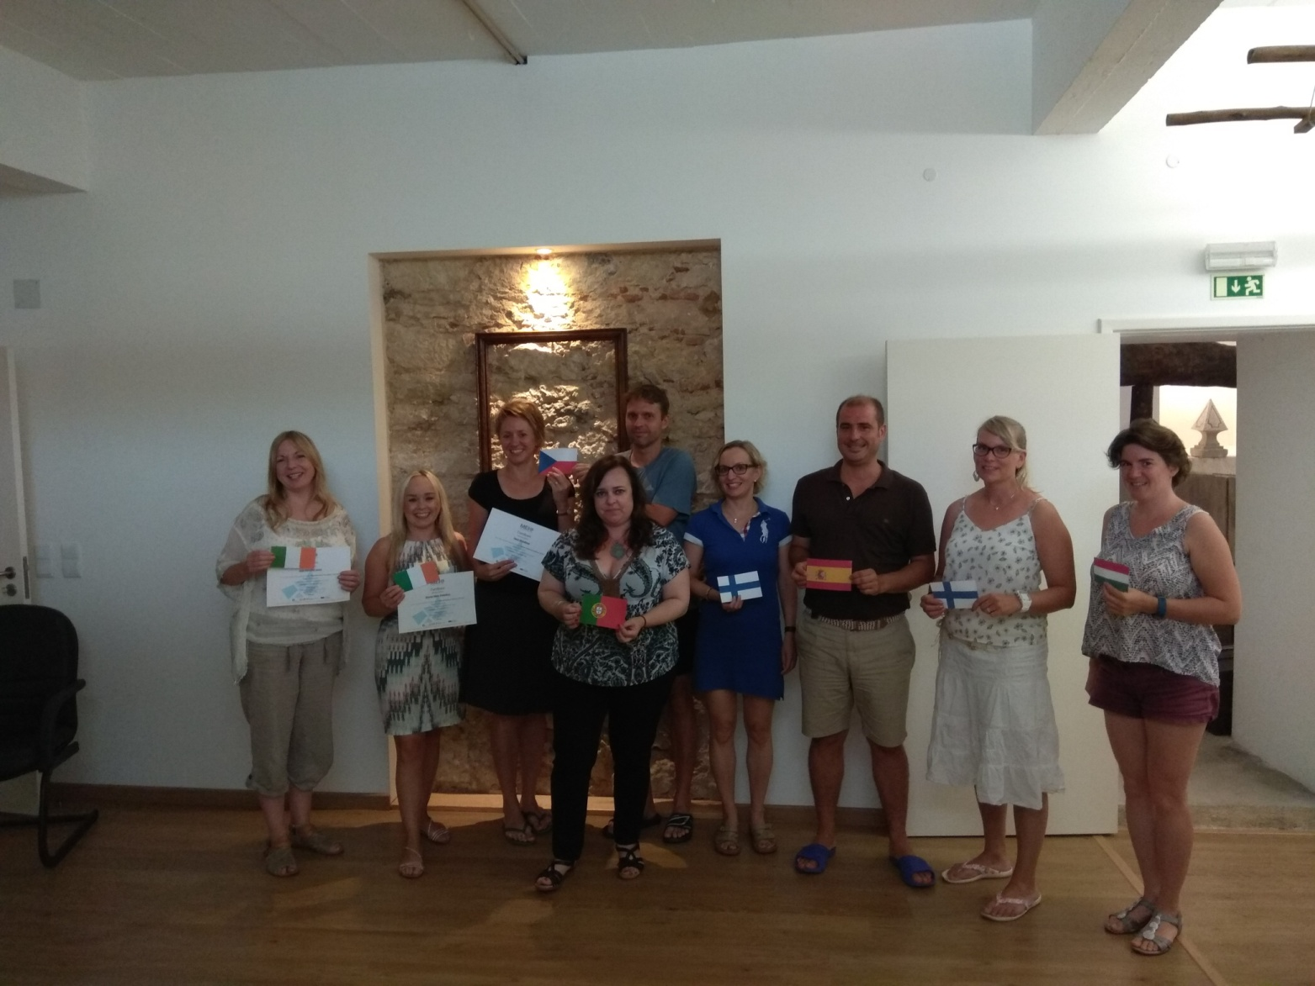
The group

Slide 5

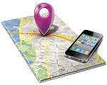



Google Mapping Tools

Slide 6

You need internet connection to use all features.
Computer or mobile
Easy to find a place
Information about places: opening hours, likes …
POIs: shops, restaurants nearby
Route planning
Real time traffic information
Timetables of public transport

Slide 7
Google My Maps
It is a personalized map.
You need a Google Account and internet to use it.
You can add place marks with photos and short descriptions.
It is stored in your Drive.
You can share or save it easily.
It can be embedded.
Many people can work on it (even at the same time).
It is very easy to use it.
http://www.arpadgimnazium.hu/zombori-anna-beszamoloja-digitalis-eszkozok-hasznalata-tanulmanyutakon/

Slide 8
A lesson with
Google my maps
Our favourite places in Budapest and in Hungary

Slide 9
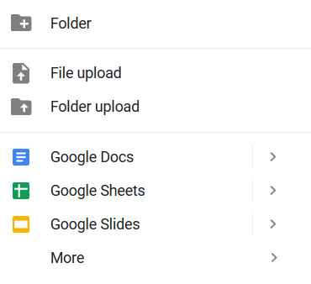

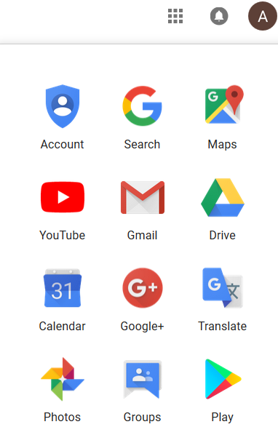

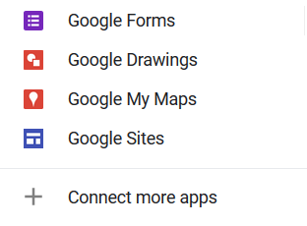
Steps to create a map with Google my maps
Enter your Google account / Gmail
Click on the 9 dots
Click on the drive icon
Click on the new icon
Click on More
Choose Google My Maps

Slide 10
Steps to create a map in Google my maps
Name your map
Choose the satellite map
Name your layer
Add a marker to your school
Create another layer
Name that layer too
Add your favourite place in Budapest, and your favourite place in Hungary (outside Budapest)
Edit your markers: picture, text, colour, style

Slide 11
Sharing a map
I’m going to share a map with you.
Open it.
Add your favorite places to the correct layers.
Edit your markers. (Work in English.)
The marker’s name should include your name.
Check what your peers did.

Slide 12
Scaffolding language for
Nice and beautiful
enjoyable, pleasant, pleasurable, entertaining, amusing, marvelous, good, lovely, great; stunning, attractive, adorable, charming, eye-catching, magnificent, picturesque, sweet

Slide 13
The use of Google my maps for educational purposes
For English lessons
For international projects
Presenting the place where you live, sights (work in groups)
Discovering places where you cannot go (important cities in the UK/US, tourist attractions in London, natural reserves in Australia …etc)
Introducing your area
Get to know the places where other participants are from
Planning the journey
Discovering a place where you haven’t been before (treasure hunting)
Dissemination

Slide 14
Google Earth

Slide 15


This is a map with many great functions and nice design.
You need to download it to use, but it is free.
You can also use a slightly different version on-line (Chrome).
https://earth.google.com/web/

Slide 16
Google Earth for educational purposes
You need good internet connection to run it.
Choosing the appropriate functions and layers is important, otherwise it can be very slow.
You cannot have multiple users.
It is great for individual work.
It is a good tool for virtual trips, you can sometimes travel in time as well.
You can create nice, personalized placemarks and tracks.

Slide 17
Adding pictures and videos for placemarks: https://sites.google.com/view/erasmus-plus-training-mapping/mapping-tools-in-stem/creating-multimedia-tracks/video-and-images-on-multimedia-track
Information about saving and editing: https://sites.google.com/view/erasmus-plus-training-mapping/mapping-tools-in-stem/creating-multimedia-tracks/kml-and-kmz
Short videos about Google Earth: https://sites.google.com/view/erasmus-plus-training-mapping/mapping-tools-in-stem/creating-multimedia-tracks
https://sites.google.com/view/erasmus-plus-training-mapping/mapping-tools-in-stem/using-and-exploring-google-earth
You can edit your placemark (colour of text and background, place of picture …etc) by using html code. Here are some templates: http://www.realworldmath.org/html-layout-tutorials.html

Slide 18
The use of Google Earth for educational purposes
For English lessons
For international projects
Presenting the place where you live, sights (alone)
Discovering places where you cannot go (presented by a student or teacher)
Literature trips: www.googlelittrips.org
Introducing your area (tour/presentation).
Get to know the places where other participants are from.
Dissemination (presentation).

Slide 19
The use of maps for international projects
Chosing the appropriate tool for diffrent purposes

Slide 20
Which tool to choose
Google MyMaps (GMM)
Google Earth (GE)
Easy to use
Easy to share or embed
Multiple users are possible
Nicer
Many features
You can create a presentation/tour
Might be difficult to run in school

Slide 21
Planning a project
Find the location of the partner school. (GM, GE)
Find out information about the partner school and its location. (GM)
Measure distance between the two schools. (GE)
Plan routes / traveling time. (GM)
Pin places you are interested it / would like to visit (GMM).
Introducing your school / city /region (GMM/GE)

Slide 22
During a mobility
Students can practice orientation (GM)
You can find POIs, opening time (GM)
You can check the schedules of public transport and plan routes (GM).
Teachers can create a treasure hunting game (GMM).
Students can create their own personalised maps with their favourite places (GMM).

Slide 23
Dissemination
You can create embedded maps to your school’s website to show where you were (GMM).
You can create presentations of the places you visited (GMM/GE).

Slide 24
Thank you!

