Slide 1
USA 2019
Horváth Kiara
8.A
2019. September

Slide 2
My trip to the U.S.A
This summer, my vacation was an amazing adventure. This country has magnificent scenery, and places that are must-visits. For example the Grand Canyon and Antilope Canyon, which are two unique places formed by the power of nature. Standing there and looking at the view is true magic, something unforgettable. My personal favourites were the Slide Rock and Zion National Park. These are more adventurous activities, and they both include ice-cold water. But if you are brave enough to try them, I am sure you will love them too.

Slide 3
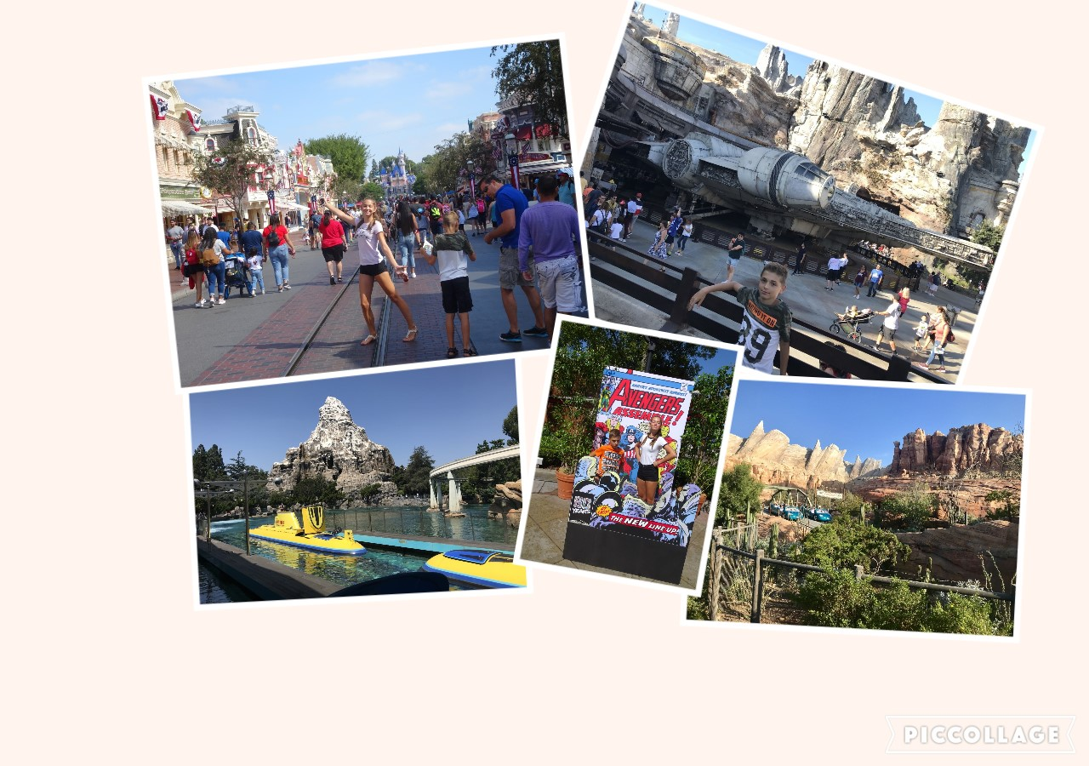
1st and 2nd day
California Adventure Park
Disneyland

Slide 4
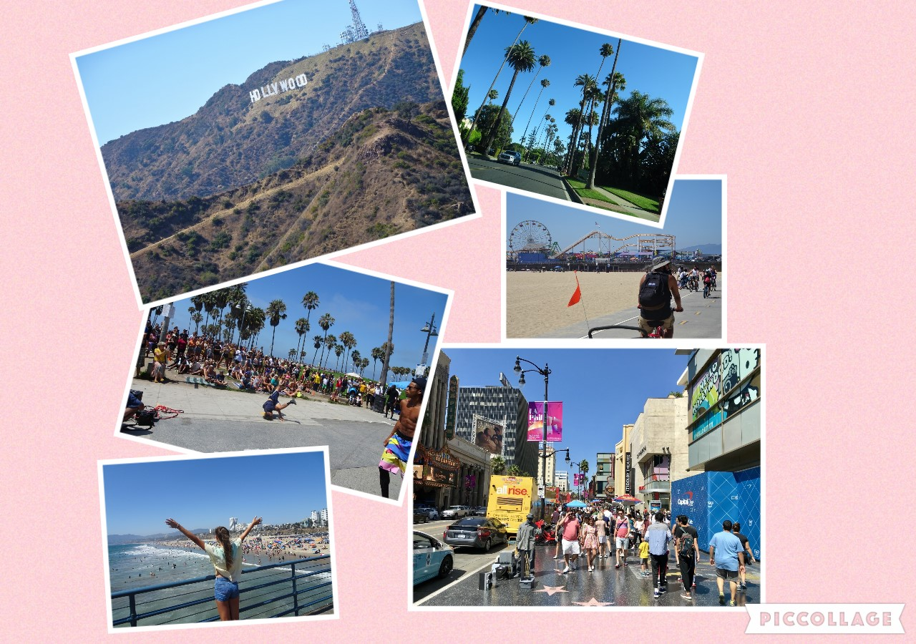
3rd and 4th day
Hollywood
Griffith Observatory
Venice Beach
Santa Monica Beach
Santa Monica Pier

Slide 5
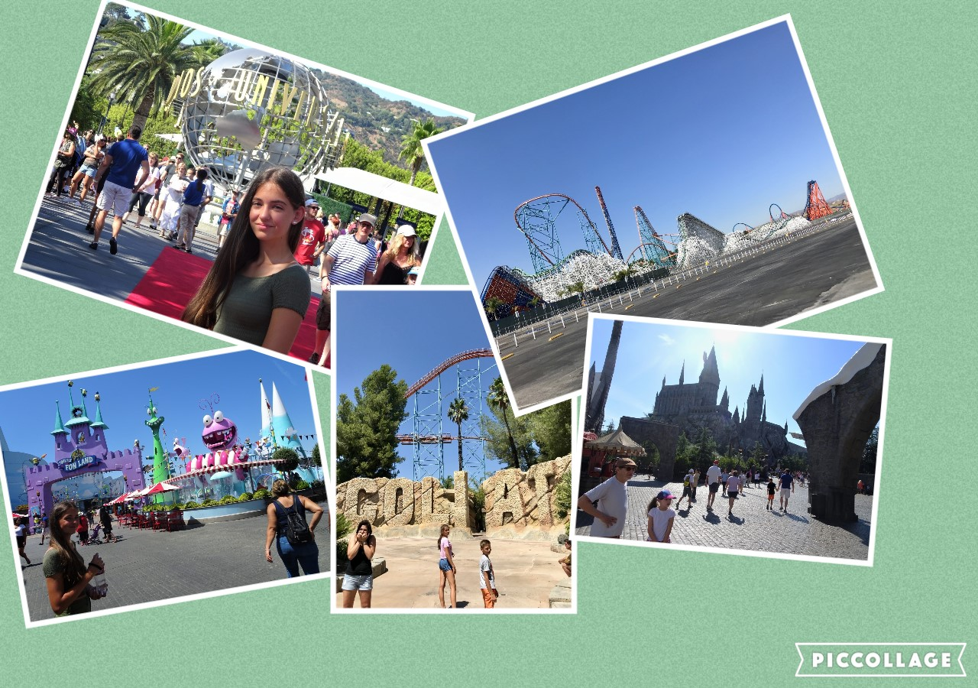
5th and 6th day
Universal Studios
Six Flags Magic Mountain

Slide 6
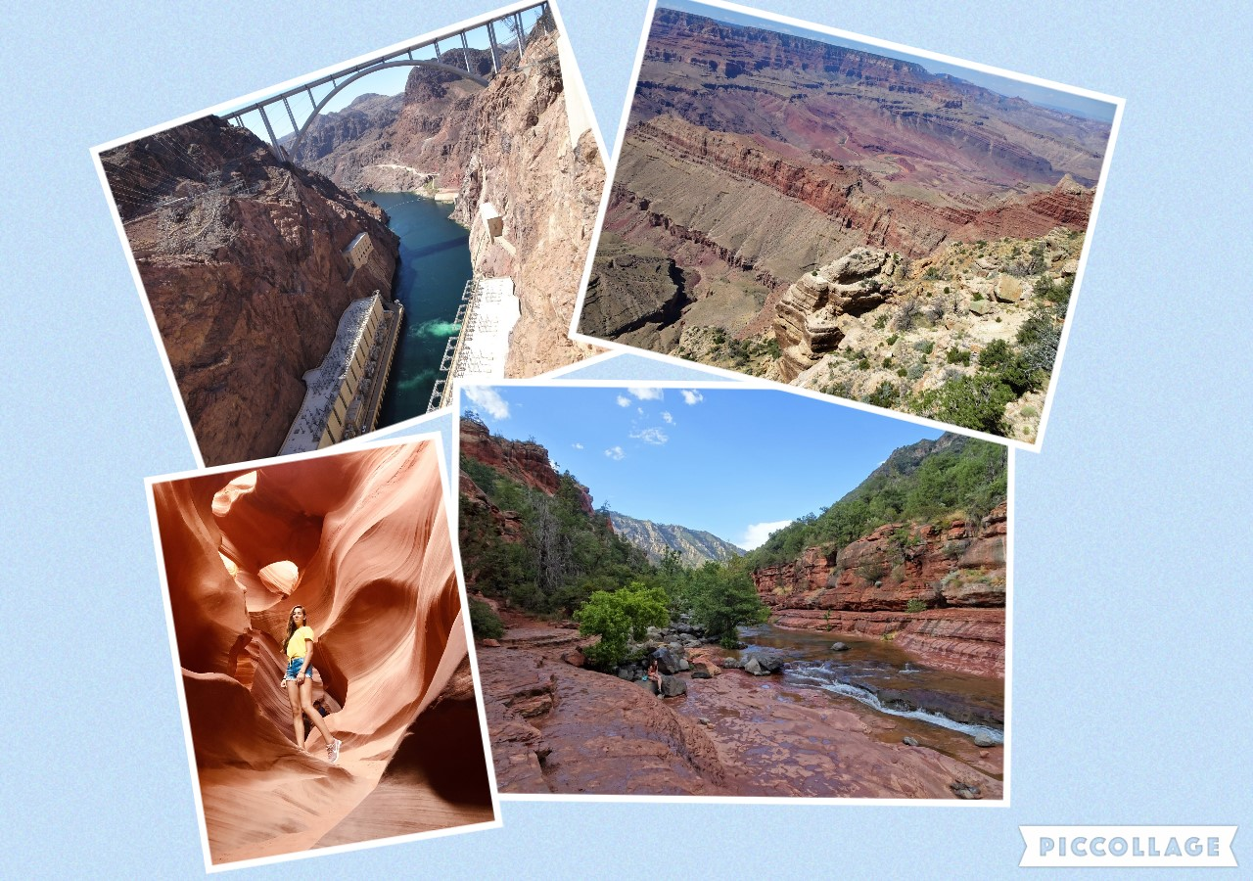
8th and 9th day
Hoover Dam
Slide Rock
Grand Canyon
Antelope Canyon

Slide 7
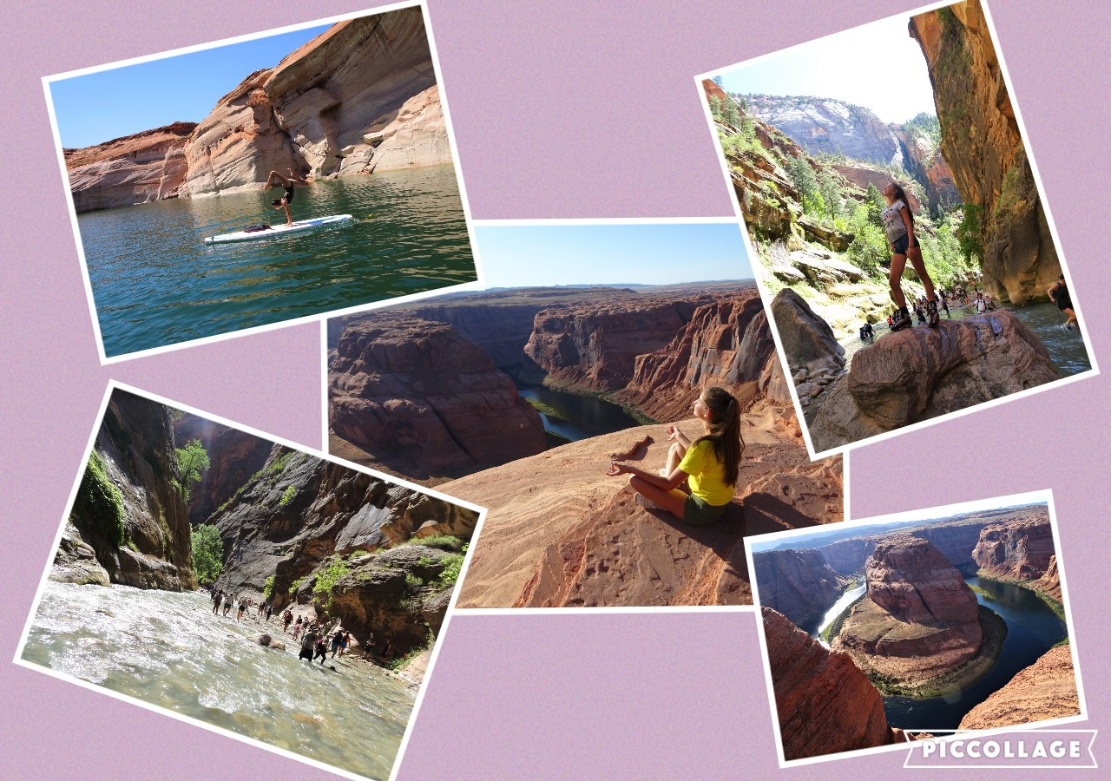
10th and 11th day
Lake Powell
Horseshoe Bend
Zion National Park

Slide 8
Las Vegas

Slide 9
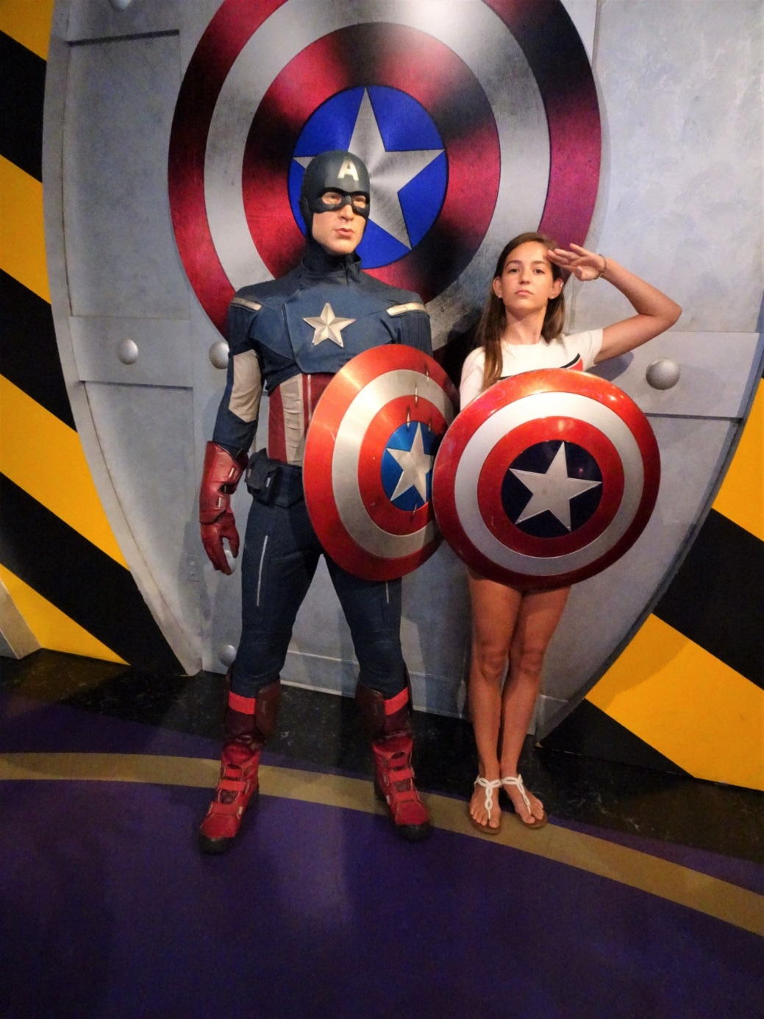
Thank you for your attention!

